Slide 1

Interactive Animations and Games
Lesson 1
Programming for a Purpose

Slide 2
Teacher Resources
For Teachers!
Lesson Overview
To kick off a unit devoted to problem-solving and developing animations and games, students begin by investigating the design of different animations and games. Students look at a variety of animations and games and attempt to match each design with a potential user. Then students choose a user and attempt to prototype an animation or game design for them on paper or in a digital template. To conclude the activity, students consider what it means to be an animation and game designer and create resources for other users.
More guidance and resources for this lesson are available in the Lesson Plan:
https://studio.code.org/s/csd3-2023/lessons/1

Slide 3
Warm Up - Option 1

Slide 4
Prompt
Interactive Animations and Games Lesson 1 - Warm Up
What's an example of a problem you've had to solve recently?

Slide 5
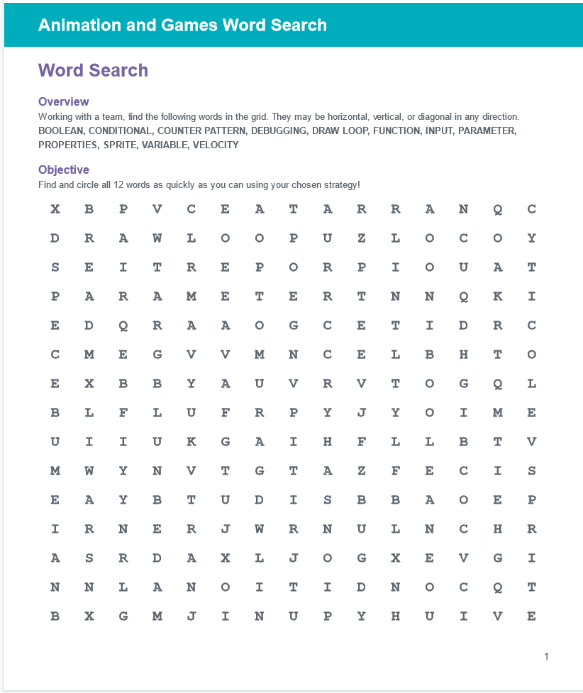
Prompt
Interactive Animations and Games Lesson 1 - Warm Up
What is the problem you are trying to solve when you do a word search?
Do NOT start on the word search yet!

Slide 6
Interactive Animations and Games Lesson 1 - Warm Up
What are the different strategies that someone could use for finding words.
What are the pros and cons to each strategy?

Slide 7
Interactive Animations and Games Lesson 1 - Warm Up
Pick one strategy you just brainstormed that you want to use to complete the word search.
Put a #1 next to that strategy.
Use that strategy to solve this problem.
IMPORTANT: if at any time the strategy you picked is not working, go back to your list of strategies and pick a new one to try!

Slide 8
Prompt
Interactive Animations and Games Lesson 1 - Warm Up
Were you successful in solving this word search problem? How do you know?
What strategy did you pick and how did it work for you?
Did anyone change strategies at any point … why or why not?

Slide 9

Interactive Animations and Games Lesson 1 - Warm Up
What are the 4 steps of the Problem Solving Process?

Slide 10
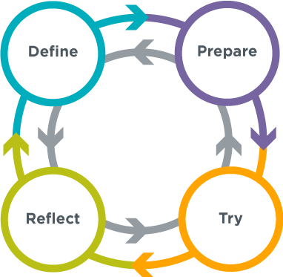
Interactive Animations and Games Lesson 1 - Warm Up
Discuss
What parts of our warm up activity do you think would fall into each step of the problem solving process?

Slide 11
Interactive Animations and Games Lesson 1 - Warm Up
Discuss
What parts of our warm up activity do you think would fall into each step of the problem solving process?
Define: when we put into our own words what the problem of a word search is and what the goal is
Prepare: the brainstorming of different strategies that could be used to solve a word search
Try: when we picked a strategy and tried to find the words
Reflect: when we reflected on how they did at the end.
If you went back to the list of strategies and picked a different one at any point when doing the word search, you were actually doing this step without realizing it.

Slide 12
Warm Up - Option 2

Slide 13
Prompt
Interactive Animations and Games Lesson 1 - Warm Up
What do you remember about the Problem Solving Process?

Slide 14
Problem Solving Process
Interactive Animations and Games Lesson 1 - Warm Up

Slide 15
Prompt
Interactive Animations and Games Lesson 1 - Warm Up
Based on what you know about the Problem Solving Process, what do you think each step could look like when designing an animation or game?

Slide 16
Interactive Animations and Games Lesson 1 - Warm Up
Some Examples
Define: Deciding what you want to make an animation or game about or who you want to make it for
Prepare: Looking at similar animations and games and deciding what kinds of colors, images, or characters you want to use, or sketching out the animation/game interface, or even planning out how to program the animation/game
Try: Creating a basic version of the animation/game (even if it doesn’t have all of the features)
Reflect: Showing it to friends to get feedback and improving the animation/game design

Slide 17
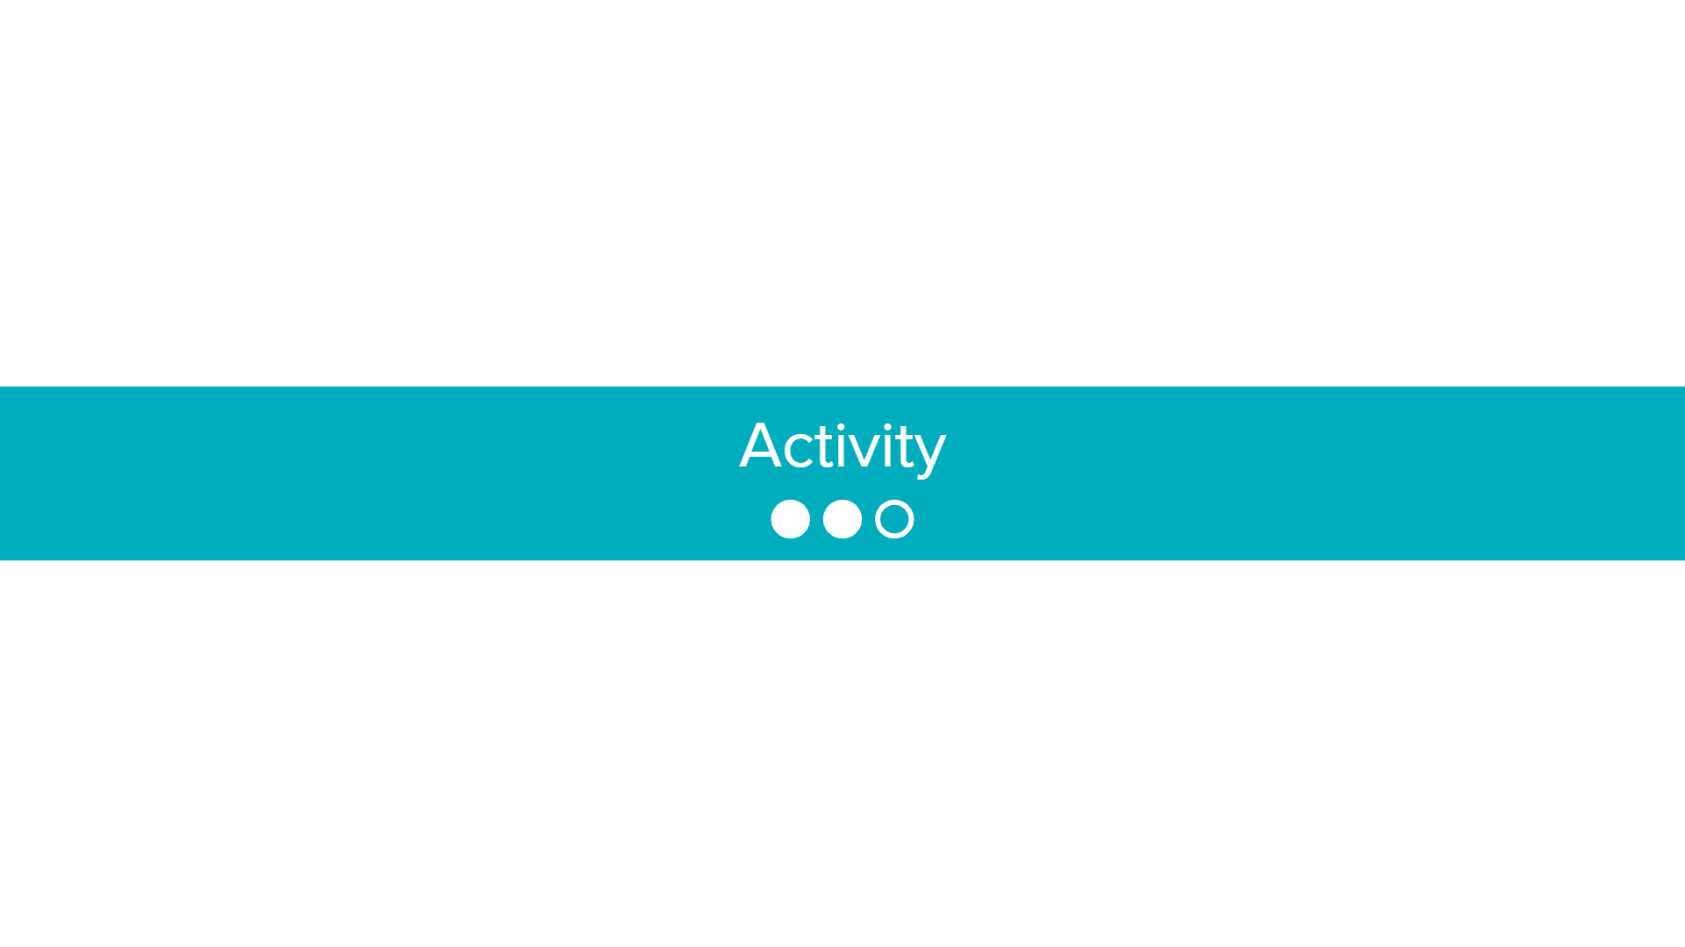

Slide 18

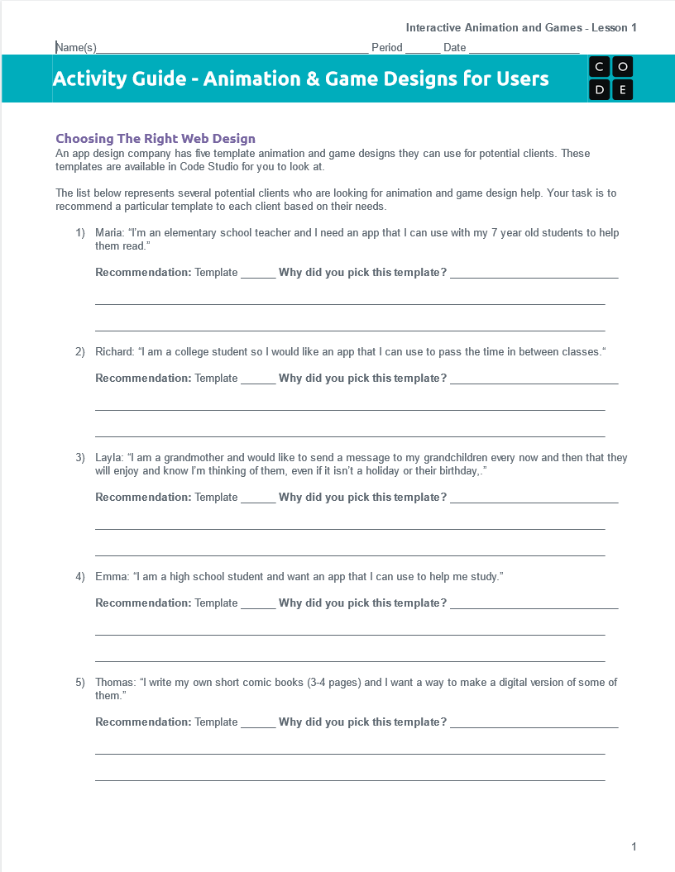

Interactive Animations and Games Lesson 1 - Activity
Distribute
You should have:
Animation & Game Design for Users Activity Guide
Pen/Pencil

Slide 19
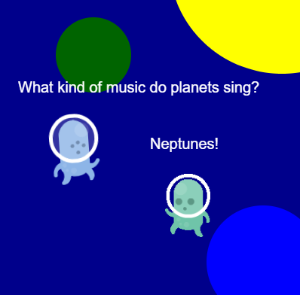
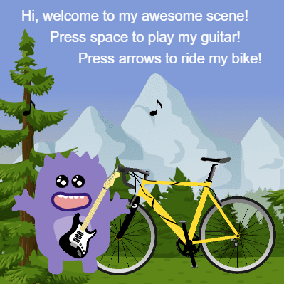
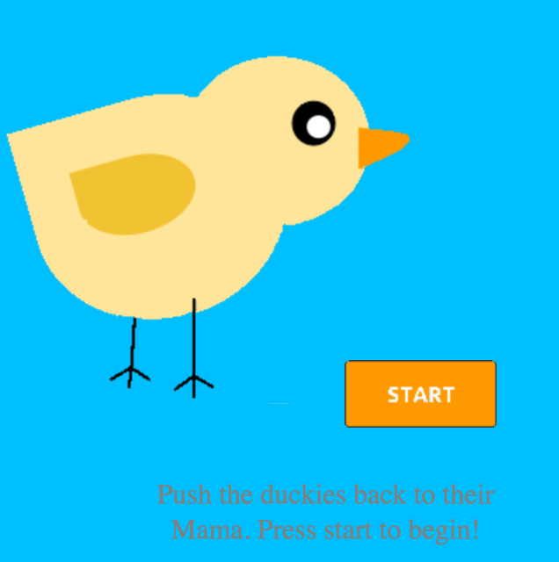
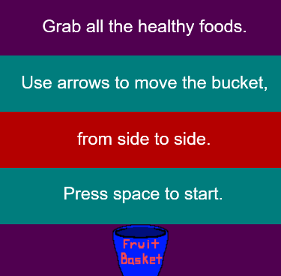
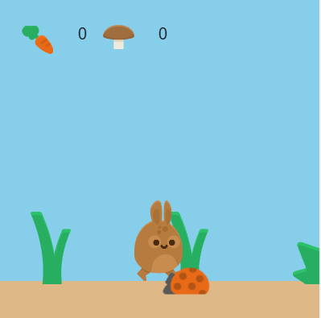
Interactive Animations and Games Lesson 1 - Activity
Recommending an App
An app design company has five template apps they can design for potential clients. These templates are available in Code Studio for you to look at.

Slide 20
Interactive Animations and Games Lesson 1 - Activity
💻
Code Studio
Log into Code Studio
Navigate to Code Studio
Lesson 1 Level 1
Sample App Design Templates

Slide 21
Interactive Animations and Games Lesson 1 - Activity
Discuss
Which users were the easiest to find matches for?
Which users were the hardest to find matches for?

Slide 22


Interactive Animations and Games Lesson 1 - Activity
Designing an App
You’ve now been asked to design an app for a client. Choose one of the clients below and circle or highlight your selection on the guide. Then, either on a sheet of paper or using a provided digital template, sketch out a design that matches the client’s needs.

Slide 23
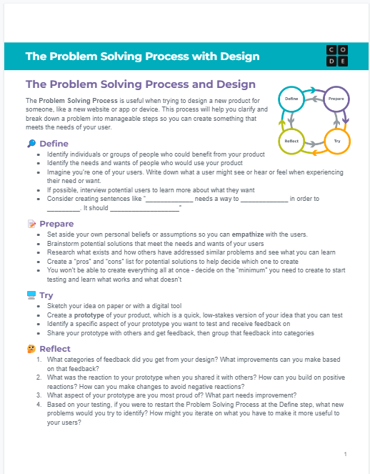
Interactive Animations and Games Lesson 1 - Activity
Distribute
You should have:
Problem Solving Process with Design

Slide 24
Interactive Animations and Games Lesson 1 - Activity
Do This
Use the steps from the Problem Solving Process to design an app for your user

Slide 25
Interactive Animations and Games Lesson 1 - Activity
Share Out
Trade your design with a different group.
What are similarities in the designs?
What are differences?

Slide 26


Slide 27

Interactive Animations and Games Lesson 1 - Wrap Up
Reflect
Complete the Reflection prompts on the back of the activity guide
What was one thing that you think your design does well and really meets the need of the user?
What’s an area that you think can still be improved to meet the needs of your user?

